Slide 1

REALESTATE PREDICTOR: AI-DRIVEN REAL-TIME PROPERTY VALUATION
VALLURU MOHAMMAD RASHEED
--20BIT0216
GUIDE NAME: GUNDALA SWATHI MAM

Slide 2

Abstract
The project is a pioneering effort to reinvent traditional real estate valuation by providing a cutting-edge real-time property valuation system.
The project's fundamental goal is to reform and modernize property valuation processes by utilizing cutting-edge technology such as artificial intelligence (AI) and machine learning (ML).
The use of multiple regression approaches, such as linear, Lasso, Ridge, and k-Nearest Neighbors (KNN), demonstrates a willingness to investigate different procedures for accurate property appraisals.
Transparency and explainability are crucial aspects meant to increase user confidence by offering insights into the AI model's decision-making process.

Slide 3

Problem definition
Traditional approaches are recognized as having limits in keeping up with the dynamic and fast-paced nature of the real estate business.
The difficulties connected with producing accurate and fast property values using traditional methods are noted as a major issue to be addressed.
Processing huge information and extracting useful insights from different property attributes are recognized as challenges that require novel solutions.
Recognizing the complexity associated with regional differences in property markets is critical, emphasizing the need for adaptation and customization in valuation methods.

Slide 4

Literature review
1. An Innovative Method to Predict Real Estate Prices using Convolutional Block Attention Module
It was published on 2023 and written by G N P V Babu, Dr. Vijayalakshmi N.S, Sameer Yadav, Dr. E. Manigandan, Chahat Gulati, Dr Aditya Kumar Singh Pundir.
They have used Convolutional Block Attention Module to develop their model.
It gives accuracy around 85%
This study intends to develop a novel method to accurately forecast real estate prices using machine learning models and actual transaction data.
Implementing CBAM adds complexity to the training process. The attention mechanisms require additional parameters, and training a model with attention mechanisms may require more data and computational resources.
It uses more memory

Slide 5
Literature review
2. Predict Condominium Prices in Bangkok Based on Ensemble Learning Algorithm with various factors
It was published in 2023 and written by T. Anchaleechamaikorn, T. Lamjiak, T. Thongpe, L. Therapeutant and J. Polvichai.
They have used Random Forest Regressor & Gradient Boosting Regressor.
This study proposes an AI-based system to evaluate condominium prices faster, more cost-effectively, and without human bias. The methodology includes web scraping and machine learning techniques to accurately predict condominium prices.
The dataset is obtained from a popular Thai property website, covering appraisal years from 2008 to 2019.
Training a large number of decision trees in parallel can be computationally expensive and memory-intensive, especially with large datasets. This can limit their applicability in resource-constrained environments.

Slide 6

Literature review
3. Real Estate Prediction System Using ML
It was published in 2023 and written by Abhinav Wandhe, Lakshya Sehgal, Hardik Sumra, Aryaman Choudhary, Mrunalee Dhone
They have used Natural Language Processing (NLP) and Convolutional Neural Networks (CNN).
A machine learning model was created in this paper to predict the likelihood of a price increase for real estate properties. The model utilizes features such as property area, age of construction, available rooms, direction of the property, and more. By incorporating these features, the system achieves over 80% accuracy in predicting price increases. This model is useful for investors and home buyers in making profitable purchase decisions.
If the quality of the textual data, such as property descriptions or reviews, is poor or contains a lot of noise, NLP models might struggle to extract meaningful features and patterns.
CNNs are designed for tasks where spatial hierarchies are important, like image recognition. In real estate data, the spatial invariance captured by CNNs might not be as relevant, as the data might not have the same grid-like structure as images.

Slide 7
Literature review
4. Using Machine Learning to Predict Housing Prices
It was published in 2023 and written by H. Prakash, K. Kanaujia and S. Juneja.
They have used Artificial Neural Network & Support Vector Regression.
Real estate is a volatile investment vehicle that impacts the global economy. A literature review was conducted to identify the most efficient models for predicting property prices. Machine learning techniques like ANN & SVM are effective in predicting accurate prices. Location and structural characteristics are important factors in predicting house prices. This study helps identify key attributes for determining property prices and the best machine learning models for research in this field.
ANNs, especially deep learning models, often require large amounts of data for training to generalize well. If your real estate dataset is limited, the model may struggle to capture the complexity of property valuation patterns.

Slide 8
Literature review
5. Productivity assessment of the real estate industry in China: a DEA-Malmquist index
It was published in 2023 and written by Xiao-xiao Liu, Hui-hui Liu, Guo-liang Yang and Jiao-feng Pan.
They have used Data Envelopment Analysis-Malmquist index.
This study explores the significance of the real estate industry for China's economy by investigating total factor productivity (TFP) of 30 provinces from 2007 to 2016. Results show that technological innovation by real estate enterprises and targeted policies by provincial government are crucial for high-quality development. The industry has a positive correlation with China's economic growth, but a negative correlation with the development of other industries..
DEA-Malmquist may face challenges in handling dynamic and rapidly changing environments. Real estate markets are influenced by dynamic factors, and the static nature of DEA might not capture these changes effectively.

Slide 9

Objectives
The major goal is to create a powerful AI-powered real-time property appraisal system, demonstrating a commitment to technological innovation.
The project's goal is to improve accuracy by implementing a variety of advanced regression approaches, with an emphasis on precision and dependability in valuation outputs.
Create a web application that can easily be understandable to end users.
Adding transparency and explainability elements displays a commitment to ensure that people understand and trust the AI model's decision-making process.

Slide 10
Scope
The project's goal is to establish a real-time property valuation system that can be tailored to different regions and property kinds. It brings together several data sources to offer a thorough picture of property assessments. The system is intended to be user-friendly, with capabilities that allow homeowners and real estate professionals to access and analyze property values by reviewing graphs and web application and collaboration with real estate specialists ensures that industry expertise is included. Scalability is also an important consideration. The initiative intends to provide a new standard for real estate appraisal procedures..

Slide 11

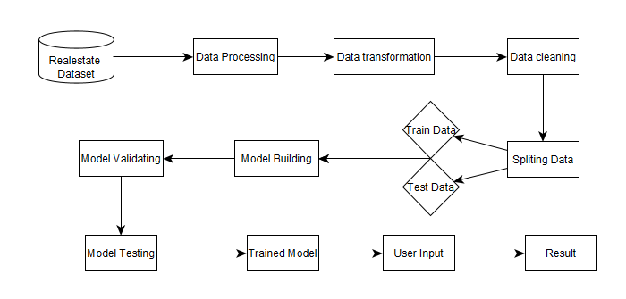
System Architecture:

Slide 12
Thanks!

